Slide 1

IBM Data Analyst Capstone Project
Cagin Bogurcu

Slide 2



OUTLINE
Executive Summary
Introduction
Methodology
Results
Visualization – Charts
Dashboard
Discussion
Findings & Implications
Conclusion

Slide 3

EXECUTIVE SUMMARY
This project analyzes global demand for programming skills using diverse data sources, including job postings, training portals, and the Stack Overflow Developer Survey. By applying data collection, wrangling, and statistical analysis techniques, key trends in programming languages, databases, and IDEs were identified.
The results are visualized in an interactive dashboard and presented to support strategic workforce planning.

Slide 4

INTRODUCTION
To remain competitive in the rapidly evolving technology sector, organizations must identify emerging skill requirements. As a Data Analyst, my role is to gather and analyze data from multiple sources to determine the most in-demand technical skills in 2024.
This study focuses on programming languages, database technologies, and IDEs, providing insights into the tools and skills shaping the global developer community.

Slide 5

METHODOLOGY
Data Collection: Scraped websites, accessed APIs, and used datasets such as the Stack Overflow Developer Survey, job postings, and training portals.
Data Preparation: Applied data wrangling techniques to clean, format, and merge data from diverse sources.
Data Analysis: Conducted statistical analysis to identify trends in programming languages, database technologies, and IDEs.
Visualization & Reporting: Designed an interactive dashboard in Google Looker Studio and prepared a presentation to communicate insights effectively.

Slide 6
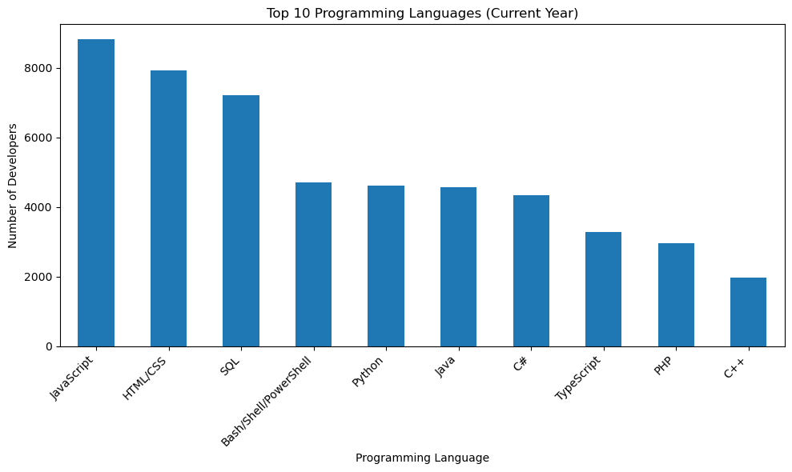
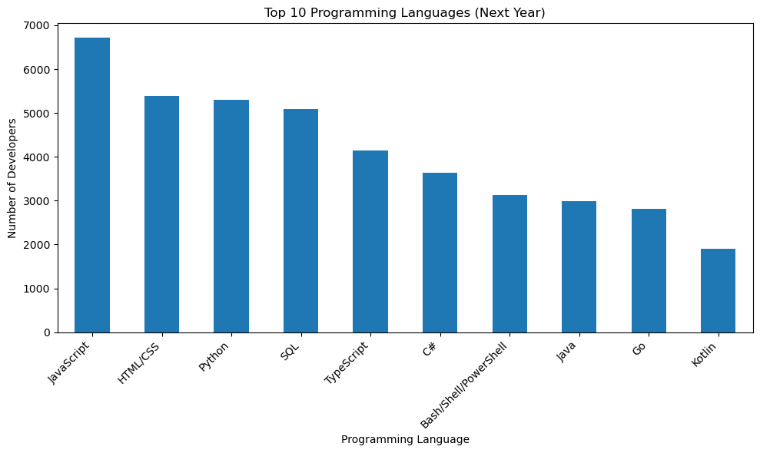
PROGRAMMING LANGUAGE TRENDS
Current Year
Next Year

Slide 7
PROGRAMMING LANGUAGE TRENDS - FINDINGS & IMPLICATIONS
Findings
JavaScript and HTML/CSS are the most used programming languages this year.
C++ is currently the 10th most used language.
Implications
JavaScript and HTML/CSS are expected to remain in the same positions in the coming years.
PHP may become outdated in the coming years.
Python and C++ are likely to become trending languages in the following years.

Slide 8
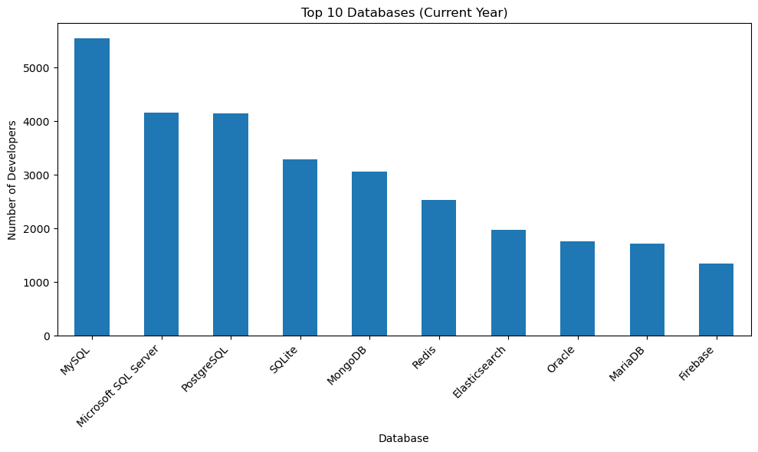
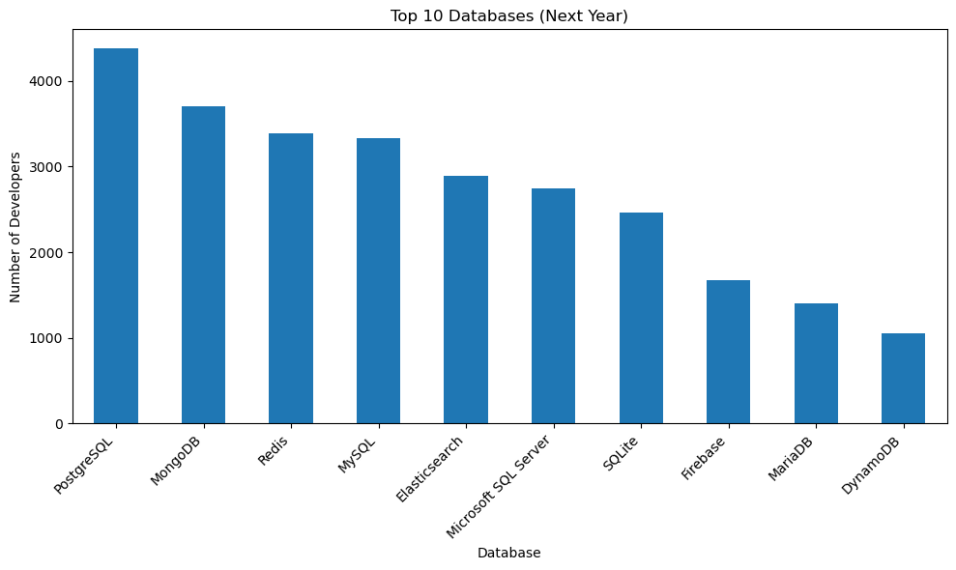
DATABASE TRENDS
Current Year
Next Year

Slide 9
DATABASE TRENDS - FINDINGS & IMPLICATIONS
Findings
MySQL is the most used database.
Firebase is currently the 10th most used database.
Implications
MySQL is expected to lose popularity in the coming years.
PostgreSQL and MongoDB are likely to become the new trends.
Redis is expected to increase its user base in the coming years.

Slide 10

DASHBOARD
You can see the dashboard screenshots created in Google Looker Studio on the next slide

Slide 11
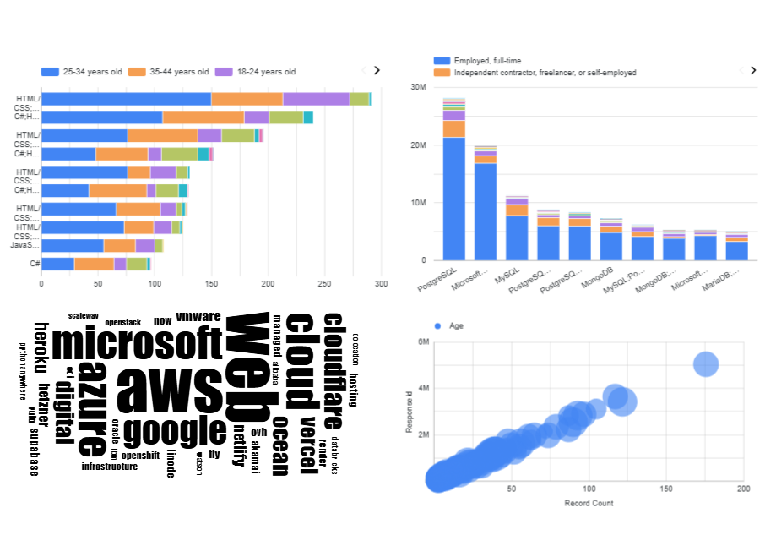
DASHBOARD TAB 1

Slide 12
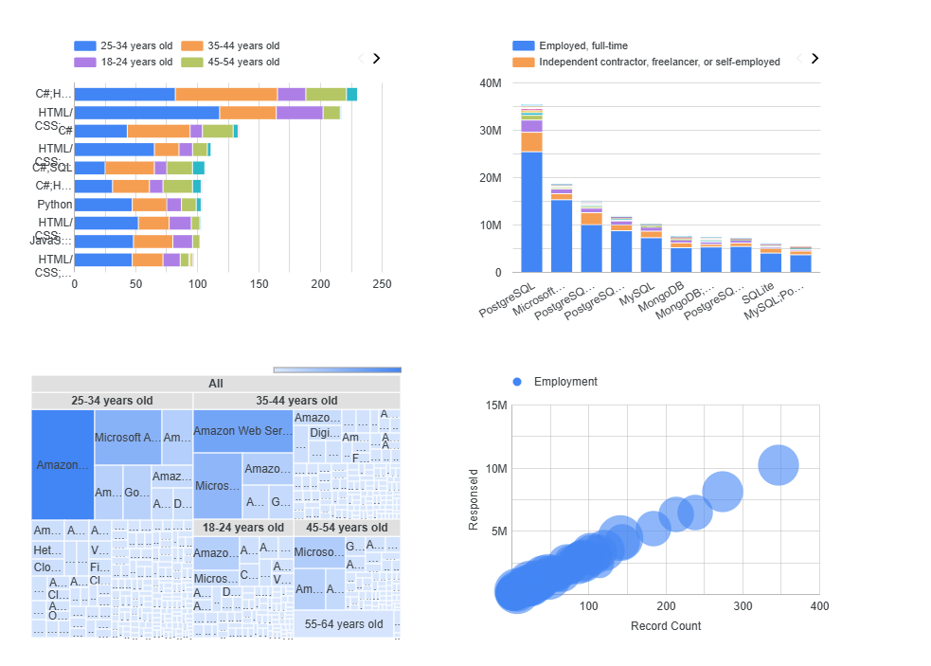
DASHBOARD TAB 2

Slide 13
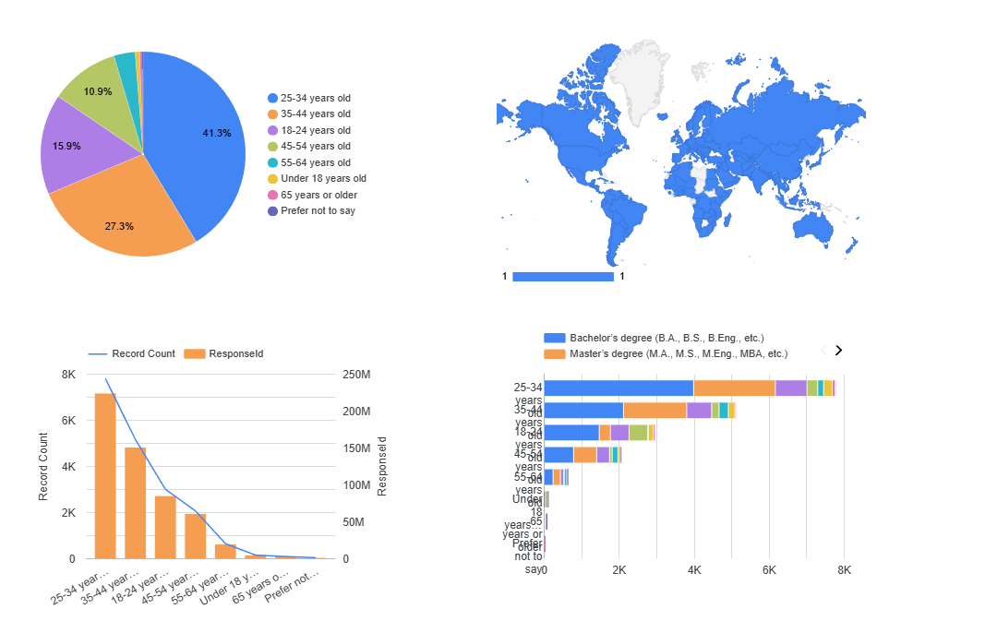
DASHBOARD TAB 3

Slide 14
DISCUSSION
The analysis of programming languages and databases highlights current trends and emerging shifts in developer preferences. JavaScript and HTML/CSS remain the most used languages due to their essential role in web development. Python and C++ are gaining traction, reflecting growing interest in data science, machine learning, and system-level programming. PHP’s declining popularity indicates a move away from older web technologies.
In the database landscape, MySQL continues to lead but may lose popularity as developers adopt more modern and flexible systems. PostgreSQL and MongoDB are emerging as new trends, while SQLite and Microsoft SQL Server usage is decreasing. Redis’s growth underscores the increasing demand for fast, in-memory data solutions.

Slide 15

CONCLUSION
Overall, the technology landscape is evolving toward languages and databases that support scalability, versatility, and modern application requirements. Organizations and developers are likely to prioritize Python, C++, PostgreSQL, MongoDB, and Redis in the coming years, while legacy technologies such as PHP, SQLite, and Microsoft SQL Server may see reduced adoption.
These trends provide valuable insights for workforce planning, skill development, and strategic decision-making in the IT industry.

